Slide 1
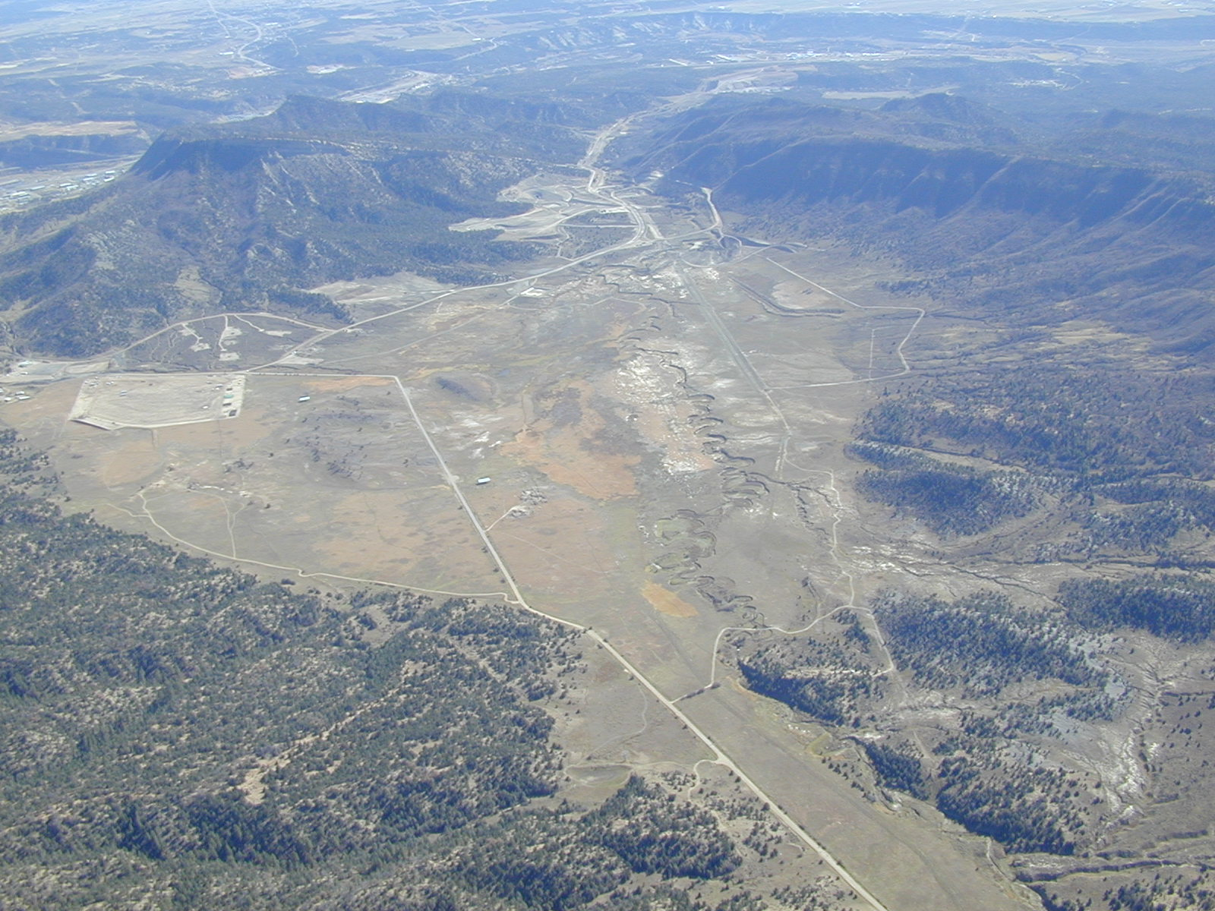
Shrinking the Scale of Social Network Analysis in the North American Southwest
James R. Allison
Brigham Young University

Slide 2
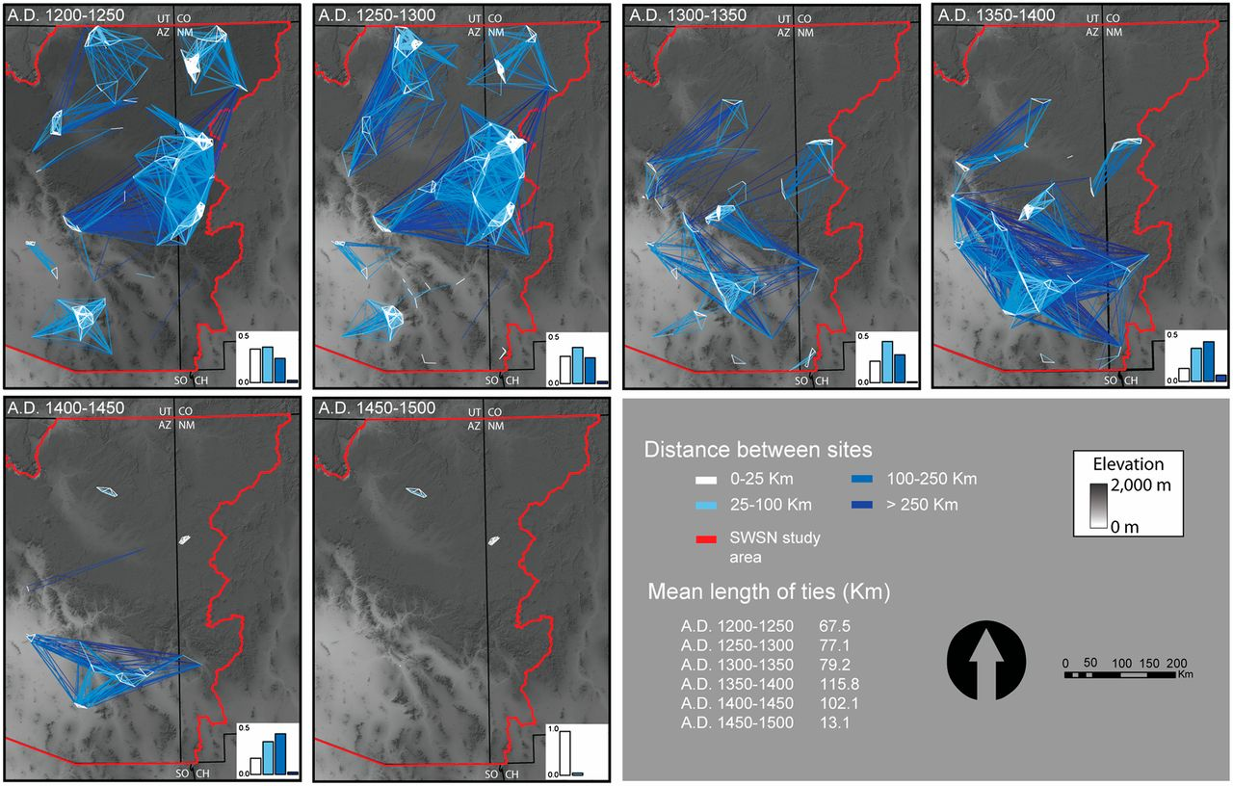
Results from the Southwest Social Networks Project
(Not My Analysis)
Regional scale networks of ceramic similarity through time.
Barbara J. Mills et al. PNAS 2013;110:5785-5790
©2013 by National Academy of Sciences
Notes:
Regional scale networks of ceramic similarity through time. These maps summarize the strongest patterns of potential connectivity across the study area by displaying ties among all settlements with ≥75% of possible ceramic similarity, color coded by the linear distance between settlements. Bar plots associated with each map show the relative proportions of connections of varying distance. The proportion of strong similarities among distant sites increases dramatically between the A.D. 1300–1350 and 1350–1400 intervals, in particular for areas below the Mogollon Rim. This shift shows that, by about one to two generations after the arrival of northern migrants in the southern Southwest, the spatial scale of connectivity among settlements had dramatically increased.

Slide 3
My Analysis
Based on Data from the Animas-La Plata Archaeological Project
74 Excavated Sites in and Near Ridges Basin
in Southwest Colorado, near Durango
Excavations Done by SWCA, Inc., from 2002-2005
(a large archaeological and environmental consulting firm)
James M. Potter Directed the Project
Many of the Excavated Sites Were Small Ancestral Pueblo Habitations
Dating to the Early Pueblo I Period (mostly late 700s AD)
Detailed Data Available on Artifact Assemblages,
Often Possible to Associate Assemblages with Individual Households
Evidence for Variation in Social Identity
Variation in Architecture, other Material Culture
Intergroup Violence Including Massacre of 30+ Individuals

Slide 4
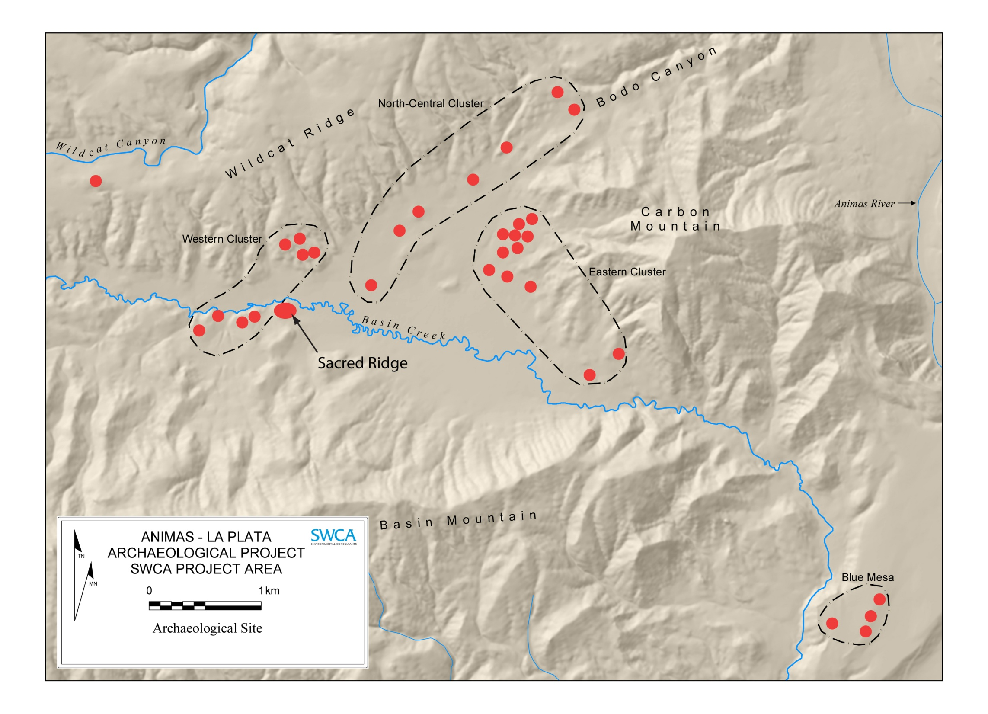
Ridges Basin, AD 750-820
Site Spatial Clusters Used By A-LP Project

Slide 5
The Animas-La Plata Archaeological Project
Ridges Basin
Southwest Colorado
Eastern Cluster
Sacred Ridge

Slide 6
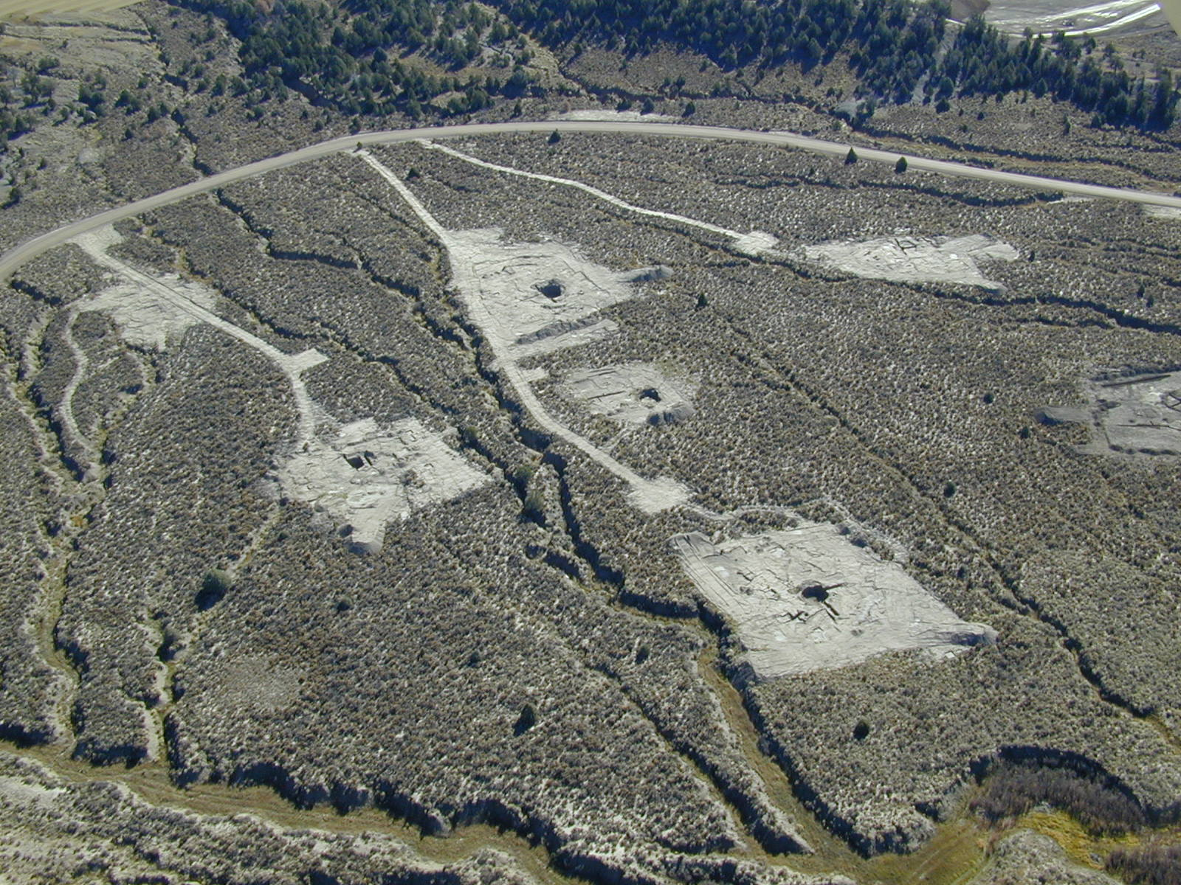
The Eastern Cluster

Slide 7
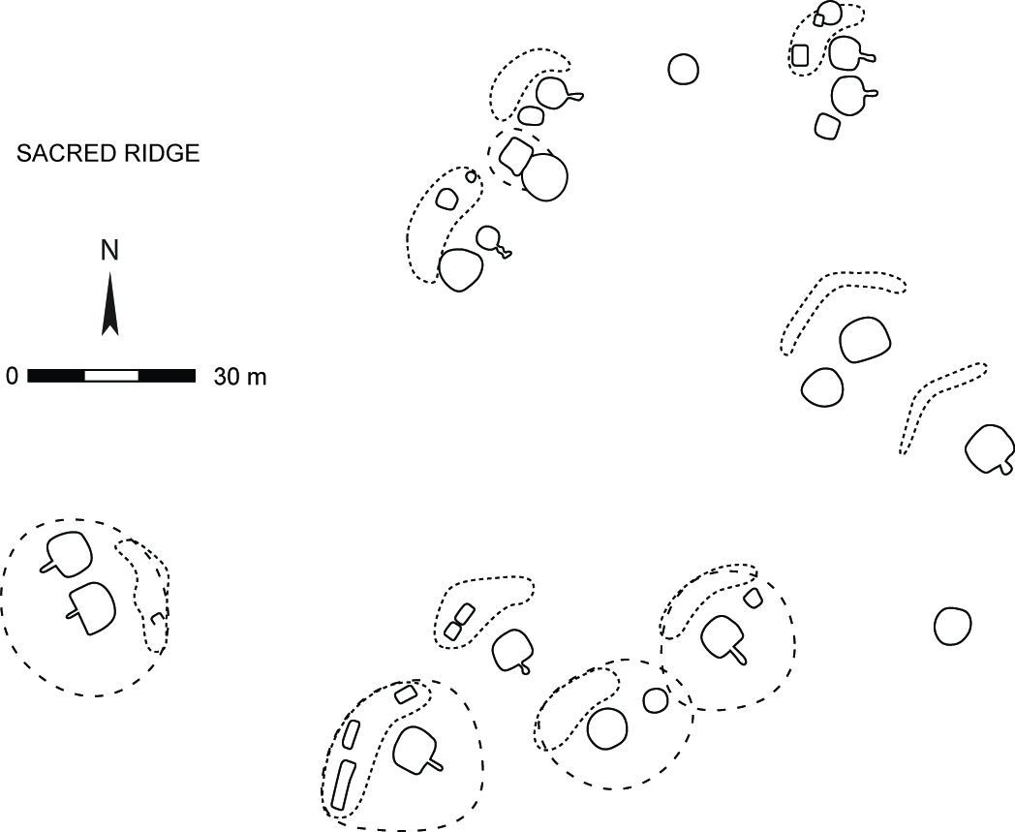
Top of
Sacred Ridge
Tower
Communal
Storage
Structure

Slide 8
Networks Formed with Four Different Data Sets
Refired colors of utility ware ceramics (25 proveniences)
(proxy for shared resource use and/or shared ceramic distribution networks)
Design elements on painted ceramic bowls (22 proveniences)
(proxy for learning contexts and/or shared stylistic preferences)
Faunal remains grouped into categories (20 proveniences)
(carnivores, waterfowl, ungulates, etc.)
(proxy for shared subsistence and other use of fauna)
General artifact types grouped into functional categories (36 proveniences)
(ceramic vessel forms from rim sherds, stone tool types,
major faunal types, etc.)
(proxy for shared broad patterns of household activities)
Weighted Networks Binarized for this Analysis by Dropping Links
below Cutoff Value (80th Percentile).

Slide 9
Questions:
How well integrated are the spatial clusters in each network?
How central (or isolated) are the Households Associated with
the top of Sacred Ridge in each network?
How often are the same households central to the networks
formed using different artifact types?
How similar are the results of network analysis
to results from correspondence analysis of the same data?
(What do we get from network analysis that we could not get
from correspondence analysis, and vice versa?)

Slide 10
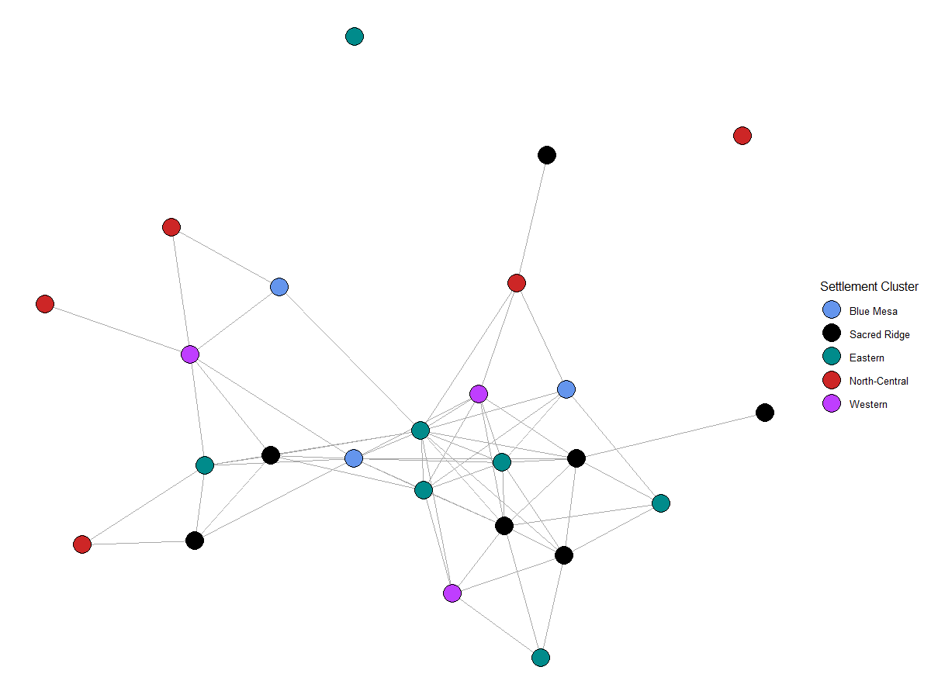
Network Based on Ceramic Refired Paste Color Similarity
(Three Most Central Sites and Top of Sacred Ridge Labelled)
Top of
Sacred Ridge
5LP177
5LP2026
Sacred Ridge
Locus 9

Slide 11
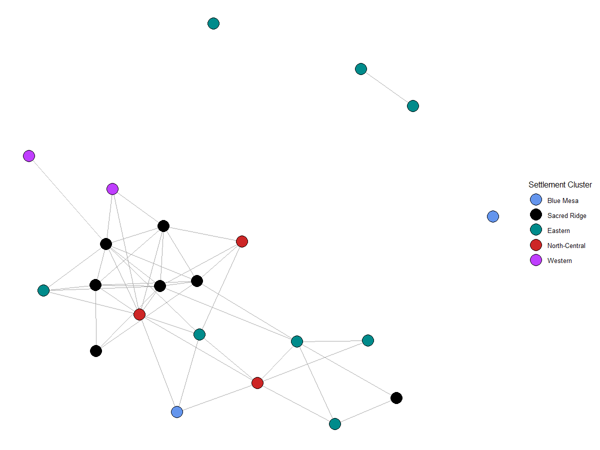
Network Based on Painted Ceramic Design Element Similarity
Rest of
Sacred Ridge
Sacred Ridge
Locus 9
Sacred Ridge
Locus 5
Top of
Sacred Ridge
5LP185

Slide 12
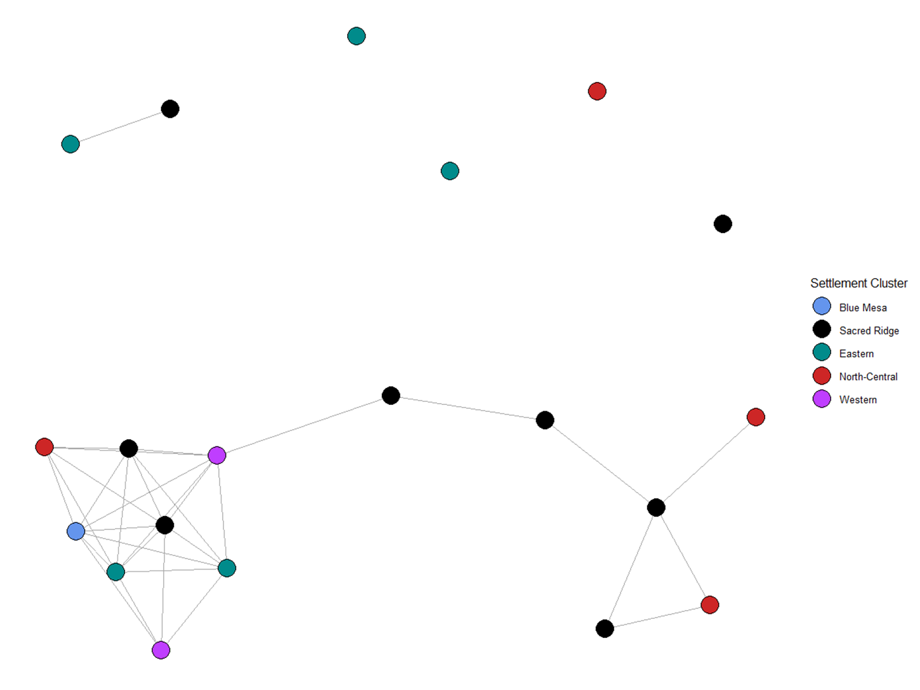
Network Based on Faunal Type Similarity
Top of
Sacred Ridge
Sacred Ridge
Locus 5
5LP2026
5LP179

Slide 13
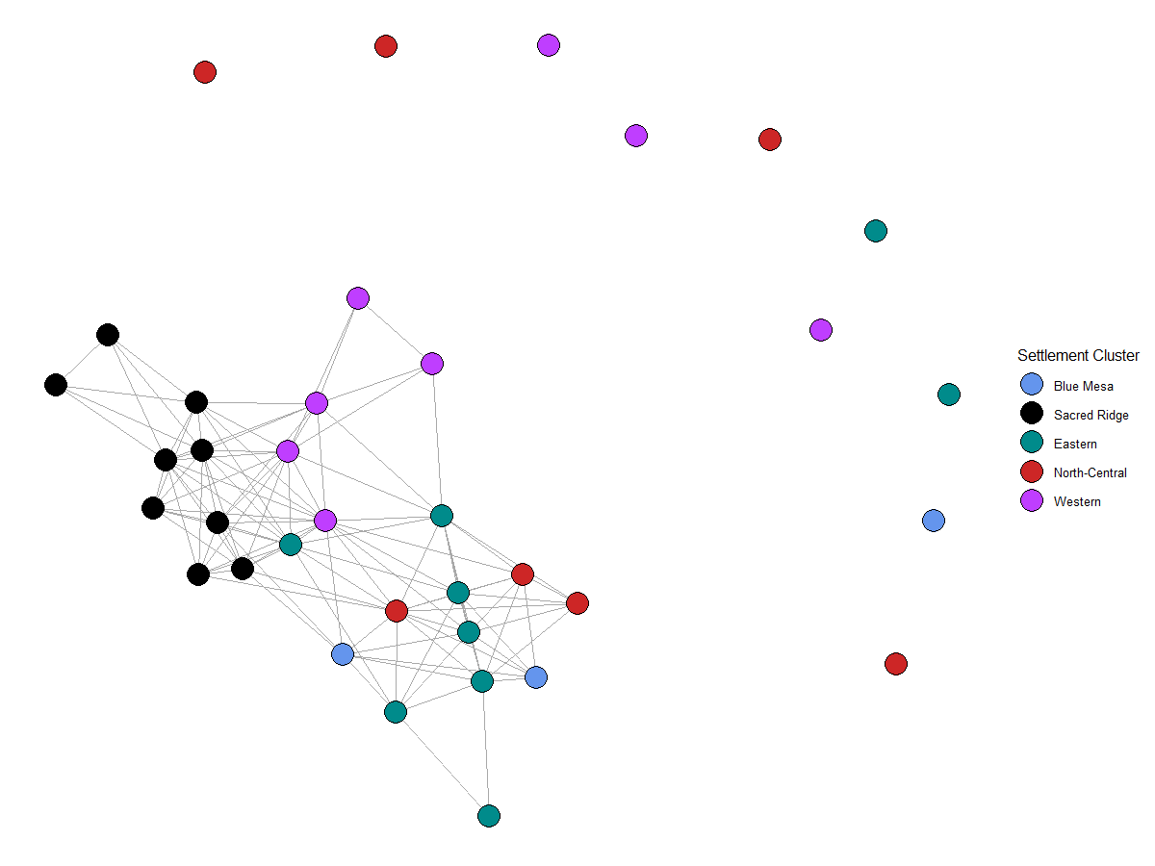
Network Based on Artifact Assemblage Similarity
5LP184
5LP244
Top of
Sacred Ridge
5LP176

Slide 14
Eigenvector Centrality Ranks for Most Central Proveniences
 | Refired Colors | Design Elements | Faunal | Artifacts |  | Mean Rank
5LP0245 Locus 9 | 2 | 2 | 15 | 5 |  | 6.0
5LP244 | 10 | 10 | 5 | 1 |  | 6.5
5LP184 | 15 | NA | 8 | 3 |  | 8.7
5LP245 Locus 5 | 9 | 1 | 3 | 23 |  | 9.0
5LP185 | 24 | 3 | 7 | 7 |  | 10.3
5LP2026 | 3 | 22 | 2 | 20 |  | 11.8
5LP179 | 13 | 19 | 1 | 18 |  | 12.8
5LP0177 | 1 | 9 | 15 | 27 |  | 13.0
5LP176 | 16 | 21 | NA | 2 |  | 13.0
Little consistency in site ranks across networks, but the most consistently central are
two loci at Sacred Ridge and two western cluster sites (near Sacred Ridge).

Slide 15
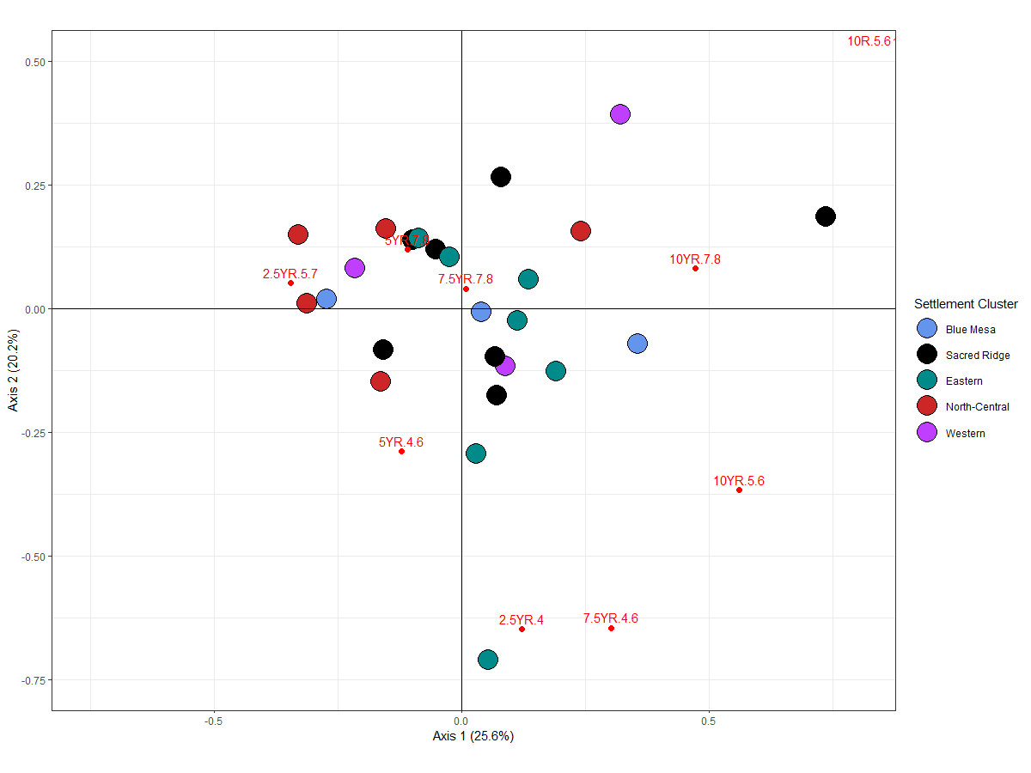
Correspondence Analysis for Ceramic Refired Paste Colors

Slide 16
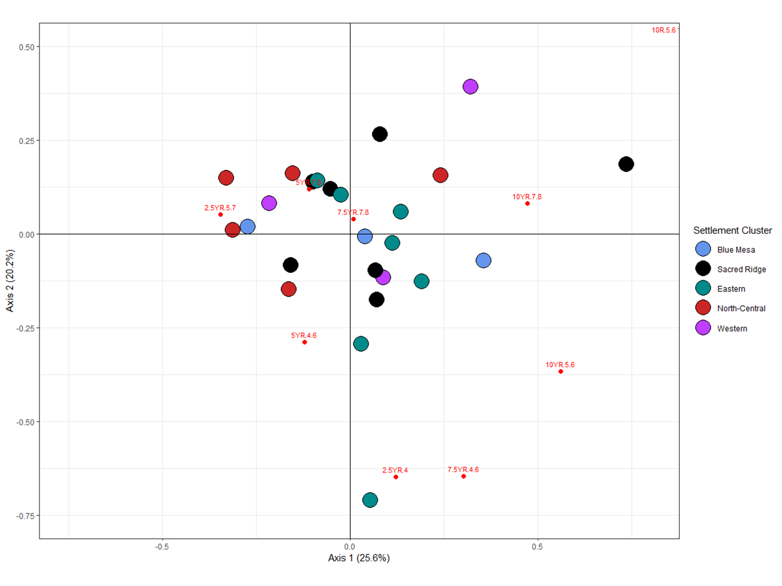
Comparison of Correspondence Analysis and Network Analysis
For Ceramic Refired Paste Colors
5LP241
5LP246
Top of
Sacred Ridge
5LP185
5LP246
5LP185
5LP241

Slide 17
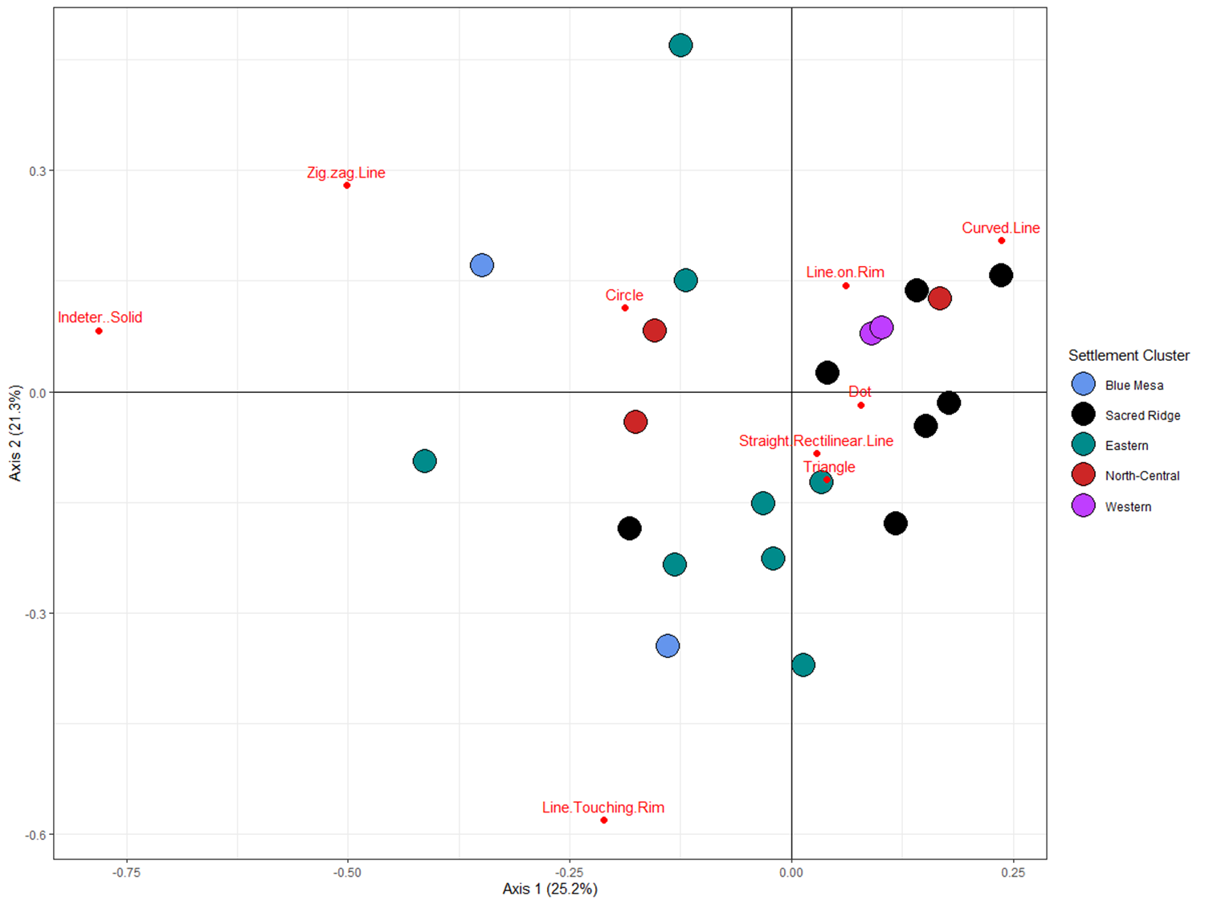

Comparison of Correspondence Analysis and Network Analysis
for Painted Ceramic Design Elements
Rest of
Sacred Ridge
Top of
Sacred Ridge
Top of
Sacred Ridge

Slide 18
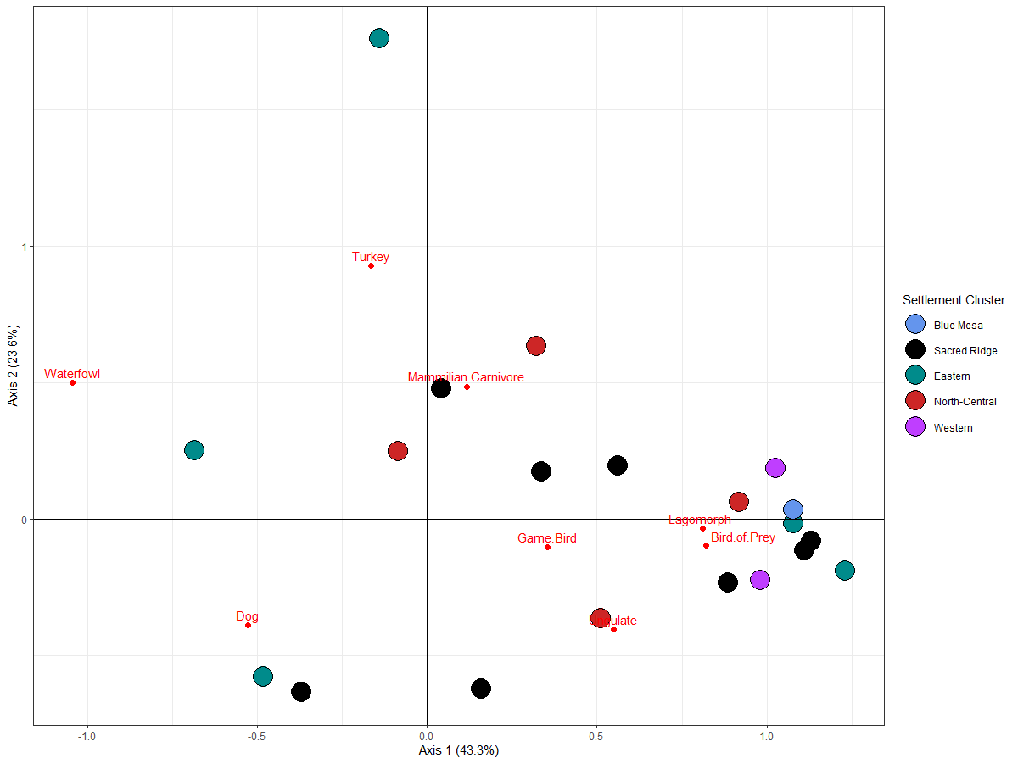
Comparison of Correspondence Analysis and Network Analysis
for Faunal Types

Slide 19
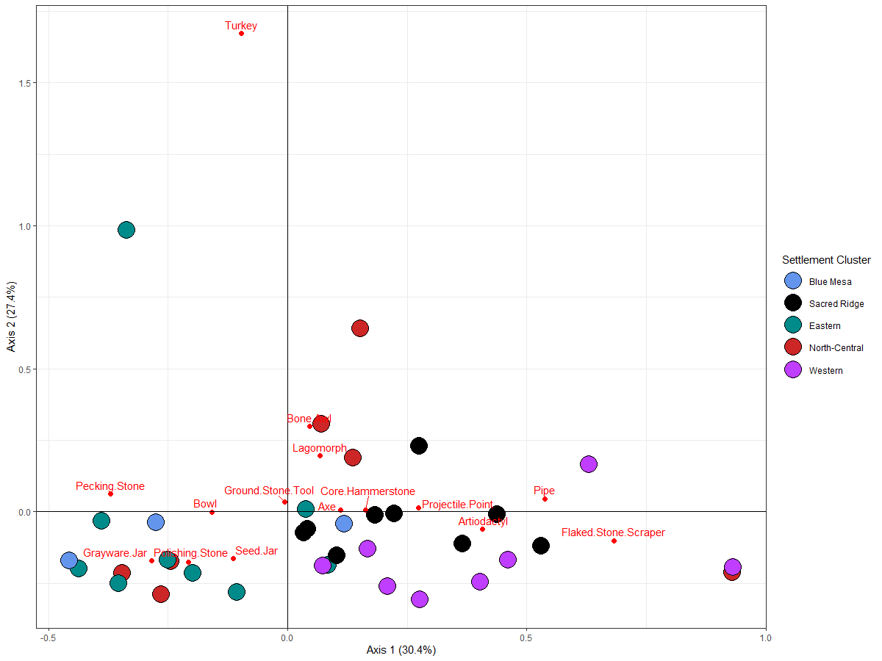
Comparison of Correspondence Analysis and Network Analysis
for Artifact Types
All of
Sacred Ridge
Most of
Western Cluster

Slide 20
Acknowledgements:
U.S. Bureau of Reclamation and Ute Mountain Ute Tribe for Managing the A-LP Project
Jim Potter and SWCA for including me in the A-LP Project
A-LP Project Staff (too numerous to name) for Excavating Sites,
Analyzing Artifacts, and Compiling Data
Sean Last and Robert Bischoff for help with R coding

